Slide 1
LSST Commissioning Overview and Data Plan Charles (Chuck) Claver Beth Willman LSST System Scientist LSST Deputy Director SAC Meeting March 5, 2017

Slide 2
Outline
Phases of LSST Commissioning
Primary Activity Sequencing:
Phase 1: Early System AI&T w/ComCam
Phase 2: Full System AI&T w/LSSTCam
Phase 3: Science Verification
Current commissioning data plan

Slide 3
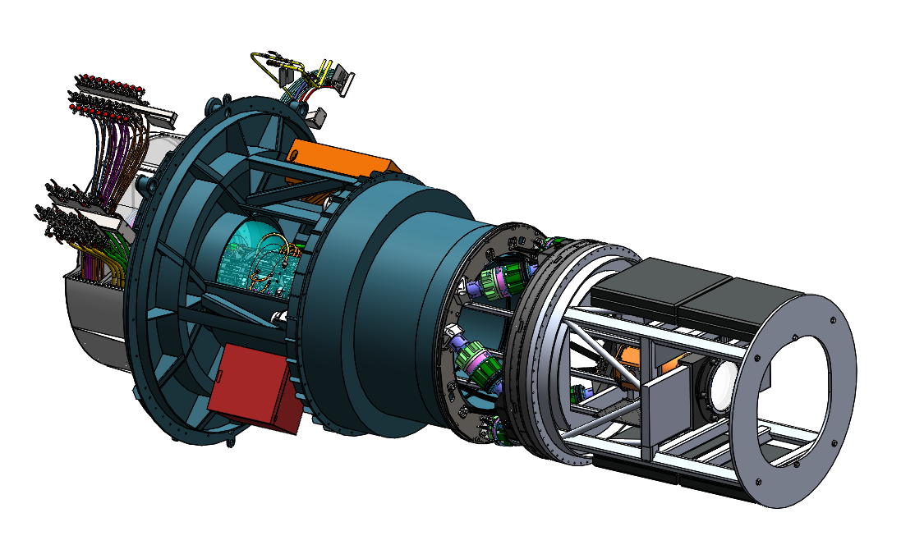
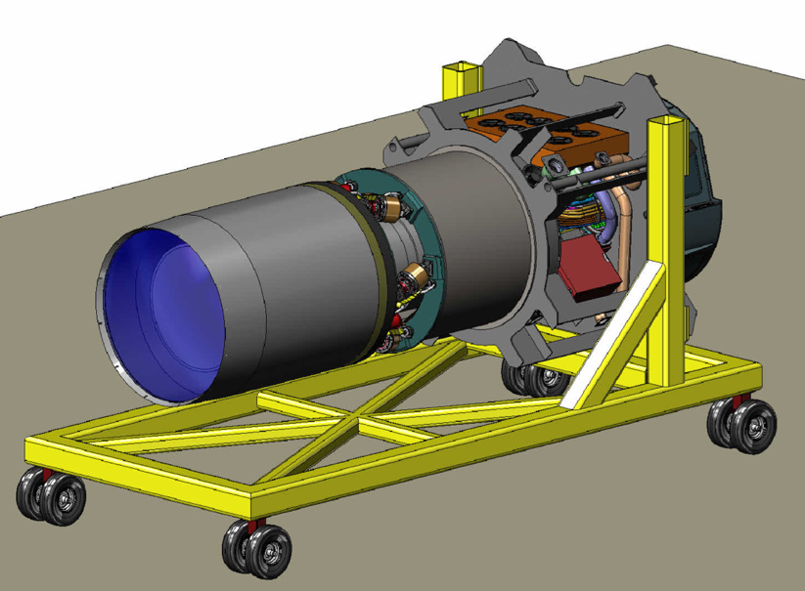
The Commissioning Plan is structured in phases
Phase 0: Pre-Commissioning - Test procedure definition - Test analysis script development using the LSST code base - Procedure & script validation with simulation tools - Special hardware/software development - Subsystem oversight an monitoring
Phase I: Early System AI&T with ComCam (6 months) - early interface testing - procedure verification - telescope alignment and AOS control - sub-scale DM pipeline testing - early science verification tests
Phase II: Full System AI&T with Science Camera (7 months) - camera-telescope integration, alignment & AOS control - full-scale DM pipeline testing - full-scale science verification test
Phase III: Science Verification (5 months) - mini-Survey 1 focus on Alert Production - mini-Survey 2 focus on 10-year depth - Data release processing
ComCam + integrating structure
LSSTCam + integrating structure on transport cart

Slide 4
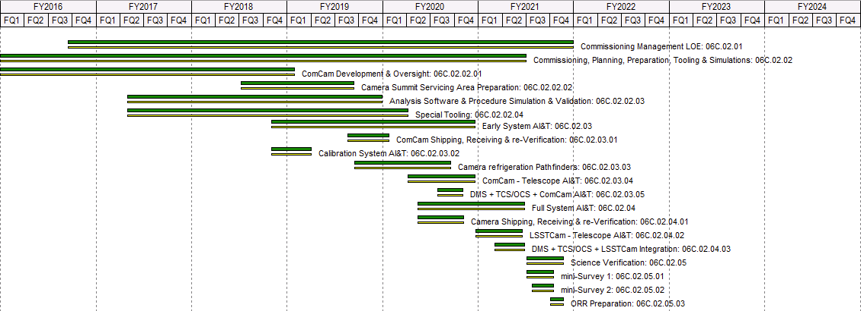
Commissioning Activity Sequencing by WBS
Phase 0
Preparations
Phase 1
Early System AI&T
w/ComCam
Phase 2
Full System AI&T
w/LSSTCam
Phase 3
Science Verification
3 planned sustained observing campaigns

Slide 5
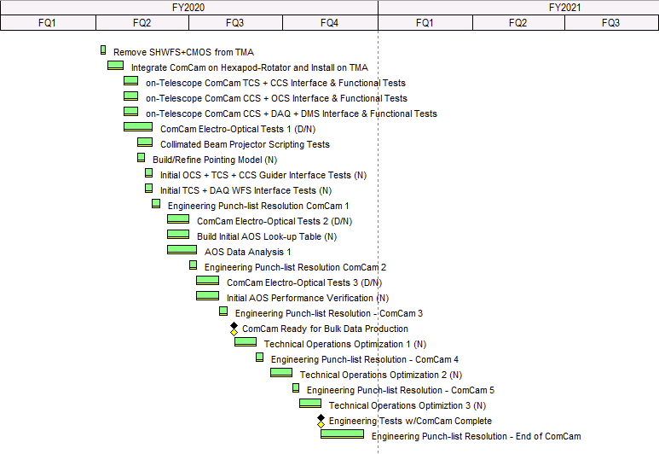
Phase 1 – ComCam – Telescope AI&T 06C.02.03.04
A single raft camera operating as a surrogate of the full science camera.
Utilizes as many LSSTCam system interfaces as possible:
CCS-OCS: Command/Control
SDS-DM: Image data delivery
WDS-TCS: Wavefront sensing
GDS-TCS: Guiding
Early interface testing and control systems verification
Electro-optical tests, optical alignment and preliminary active optics verification
Sustained observing campaigns and operations optimization
Conceptual layout of ComCam with Camera surrogate mass integrated to rotator interface and telescope integrating structure.

Slide 6
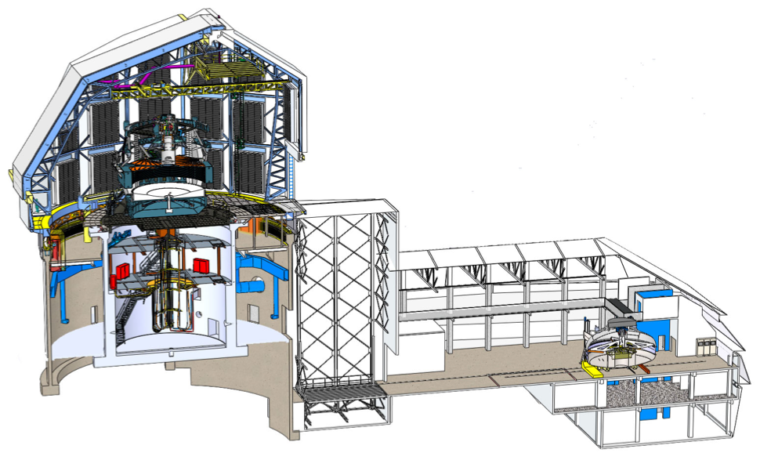
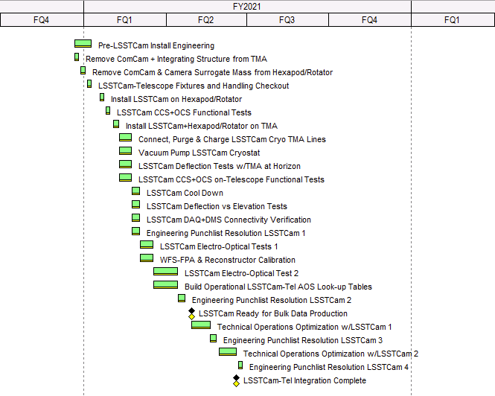
Phase 2 – Camera-Telescope AI&T 06C.02.04.02
Pre-LSSTCam installation procedure and safety checkout, physical integration and functional tests
LSSTCam start-up and OCS/TCS/CCS interface verification
LSSTCam electro-optical tests, optical alignment and final active optics verification
LSSTCam - Telescope integration focus includes:
Physical installation and basic functional checkout of LSSTCam
Final calibration and verification of active optics look-up tables and optical feedback
Integrated system requirements verification (OSS)
OCS sequencing & functional interactions with scheduler driven observing
Full scale sustained observing campaigns and operations optimization

Slide 7
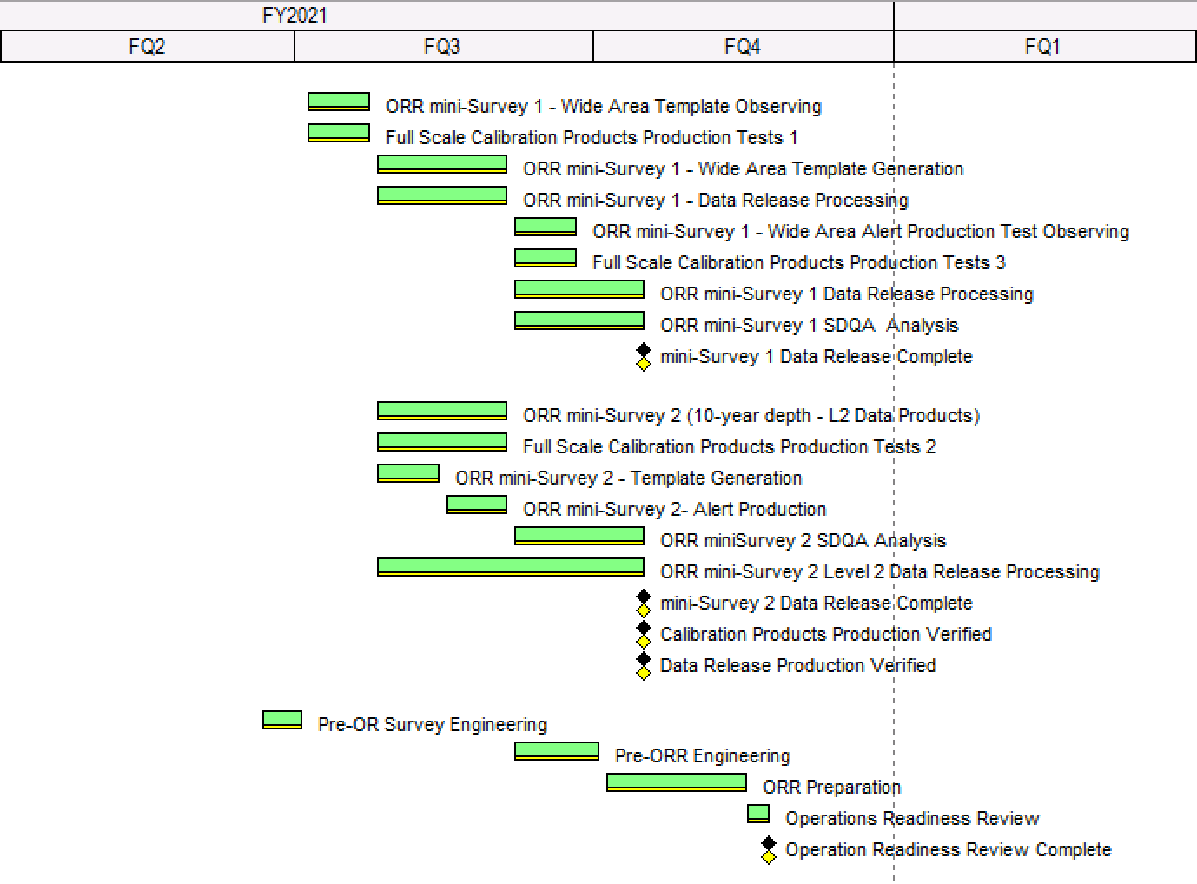
Phase 2 – Science Verification mini-Surveys: 06C.02.04
Image differencing template acquisition
Template processing and & generation
Level 1 Alert Production Verification
Level 2 10-year Equivalent
Science Verification focus includes:
Final verification of Alert Production
Final verification of 10-year data release processing (over limited area)
Verification of the LSST Science Platform services (internal users)
Exercising the SDQA tools

Slide 8
Data Production Milestones

Slide 9
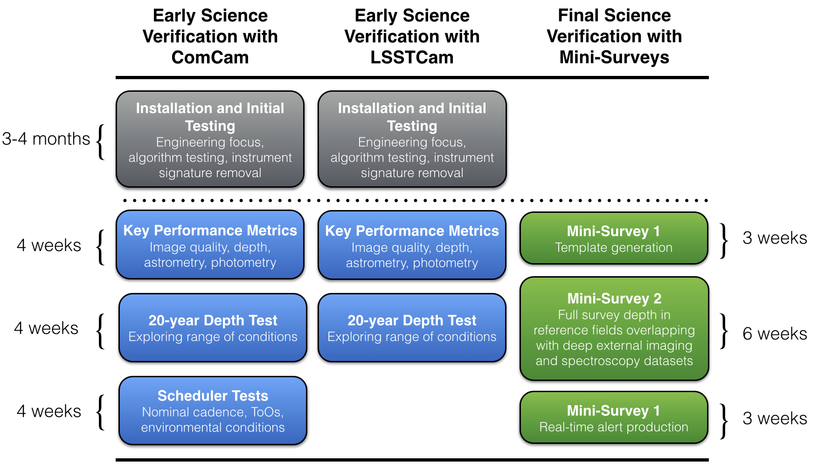
Sustained Observing Periods during Commissioning

Slide 10
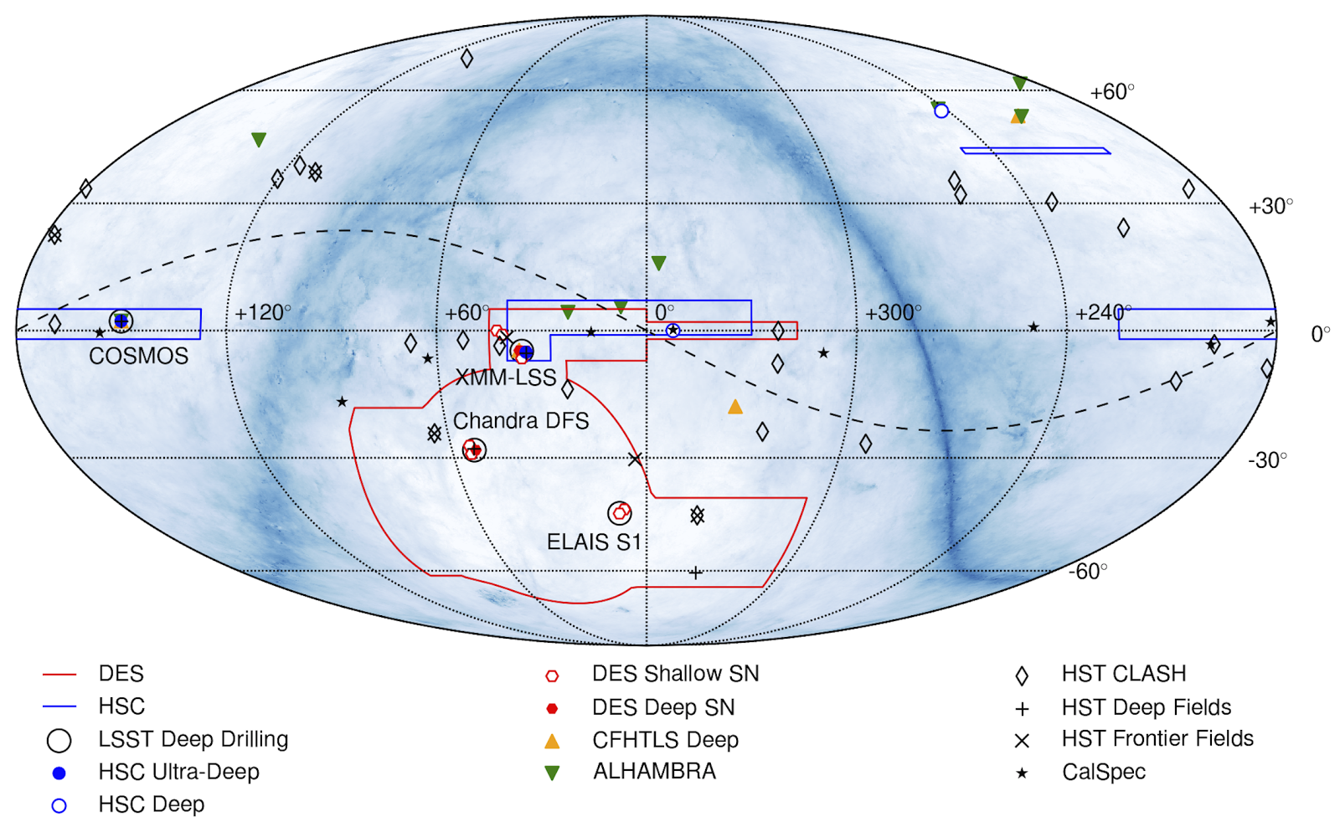
Candidate reference fields/area for LSST Commissioning Observations
Additional input welcome.
What early observing can be done to further establish reference fields?

Slide 11
Early Science Verification with ComCam
Science images with ComCam provide a first opportunity to test DM software with LSST images
Gradual transition from engineering focus to periods of sustained observing

Slide 12
Early Science Verification with LSSTCam
Repeat sequence of early science verification observations and analysis from ComCam with LSSTCam, making use of experience and analysis tools gained with ComCam
Focus on range of delivered performance over larger FOV

Slide 13
Final Science Verification with Mini-Surveys
5-month period demonstrating operational readiness
Two 6-week continuous scheduler-driven mini-surveys exercising the Level-1 and Level-2 data production systems, respectively
Comprehensive characterization of bulk data acquired under nominal observing conditions
Identifying corner cases with the aid of a larger statistical sample of observations

Slide 14
Mini-Survey 1: Wide-Area Alert Production
Objectives:
Template building with DRP pipeline
Level-1 processing, real-time alert generation
Testing survey progress over wide area, validating observation simulations
Observations:
~1600 deg² x 15 visits x 6 filters x 2 phases (~30,000 visits, ~40 nights)
In each phase, cover ~10% of footprint with exposure equivalent to 1 year of Wide-Fast-Deep survey
Long equatorial stripe covering range of source densities
Phase 1: Observations for template generation (3 weeks)
Phase 2: Re-observing area for alert production (3 weeks)
Phases separated by 6 weeks to allow for astrophysical evolution and template processing (mini-survey 2 scheduled in-between phases)
1 visit = 9.6 deg², 825 visits per field in 10 years (~1 night per field)
~2,000 fields in the main deep-wide fast survey, 2.5 million total

Slide 15
Mini-Survey 2: 10-year Depth Survey
Objectives:
Focus on Level-2 data products at full survey depth
Data quality characterization beyond the SRD through analyses that are closely tied to main science themes
e.g., source detection completeness, star-galaxy separation, photo-z, weak-lensing null tests, cluster weak lensing
Template generation and real-time alert production; these high-cadence observations will form an exceptional dataset for detailed characterization of transient, variable, and moving object alerts
Observations:
~30 fields x 825 visits in 6 filters (~25,000 visits, ~30 nights)
~300 deg² to full depth of Wide-Fast-Deep survey (~1% of footprint)
Select fields to overlap with external reference datasets
Scheduler used to optimize data quality across fields

Slide 16
Providing Input to the Commissioning Team
The Commissioning team’s priority during the entire Commissioning period will be integrating and testing the hardware and software systems to ensure that they will deliver on the scientific requirements defined for the 10-year survey
The Commissioning team may have some flexibility in the observing strategy and/or target fields to be implemented in each of the three commissioning phases. To prepare for this possibility, we plan to invite commissioning suggestions via a public GitHub website in 2018.
The LSST Commissioning lead, with support from LSST’s Science Advisory Committee and Project Science Team, will evaluate community commissioning suggestions to determine which of them would drive the system to operational maturity most efficiently. LSST might not guarantee that any particular observations or observing strategies will be implemented during commissioning.

